Slide 1
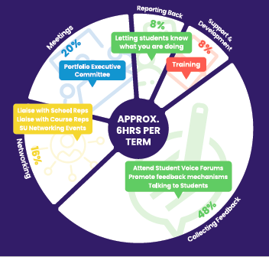
Become a Course Rep
What does a Course Rep do?
Feedback Online
Course Reps are a vital part of the 3 ways to make your voice heard.
You do not need any prior experience to be a Course Rep, just a passion for representing the views of students and an ability to attend the Student Voice Forums each term. Nominate yourself through [the online form] before [insert date].
Attend a Meeting
Talk to a Rep
Beds SU will provide training for all Course Reps

Slide 2
Benefits
Skills & Attributes
Things you’ll learn and develop:
Listening
Research Skills
Create positive change for yourself
and others
Direct links to academics running
your courses
Demonstrate your skills in a position of responsibility
Looks great on your CV!
Support from Rep Development
Coordinator & wider SU Team
Problem Solving
Time Management
Approachable
Committee Skills
Negotiation Skills
Why become a course rep?

